Slide 1

Fast point multiplication on Elliptic Curves Using Isogenies
Suhas Aggarwal

Slide 2
Elliptic curve cryptosystems are usually implemented over fields of characteristic two or over (large) prime fields.
For large prime fields, projective coordinates are more suitable as they reduce the computational workload in a point multiplication.

Slide 3
In this case, choosing for parameter a the value -3 further reduces the workload
Over Fp, not all elliptic curves can be rescaled through isomorphisms to the case a = -3.

Slide 4
Normal point addition:
P =(x0,y0)
Q=(x1,y1)
R=P+Q (x2,y2)
x2=e^2-x0-x1
y2=(X2-X1)e-y1
e=(y0-y1)/(x0-x1) when P!=Q ,
e=(3*(x1)^2+a)/ (2*y1),otherwise

Slide 5
It is possible to obtain the desired value
a = -3 for an isogenous elliptic curve and to
perform computations on this curve rather
than on the original one.
Being isogenous, both curves have the same
number of rational points and mappings between
curves (called isogenies) allow to relate point
multiplication in both groups.

Slide 6
Addition : (Projective coordinates)
The correspondence of P (X0 : Y0 : Z0)
with its affine co-ordinates is given by
P(x0,y0) where x0=x0/z0^2 ,y0=y0/z0^3
If z0 !=0 , and p=O ,if z0=0 .

Slide 7
P=(x0:y0:z0)
Q=(x1:y1:z1) (with P!=-Q and Z0,Z1 !=0)
P+Q=R(x2:y2:z2)
x2=R^2-T*W^2
2*y^2=V*R-M*W^3 when P!=Q
z2=z0*z1*W

Slide 8
U0= x0*z1^2
U1=x1*z0^2
S0=y0*z1^3
S1=y1*z0^3
W=U0-U1
R=S0-S1
T=U0+U1
M=S0+S1
V=T*W^2-2*X2
Notes:
S1

Slide 9
x2=M^2 – 2*S
y2=M*(S-x2)-T
z2=2*y1*z1 (when P=Q)
With –
M=3*x1^2+a*z1^4
S=4*x1*y1^2
T=8*y1^4

Slide 10
Addition of 2 different points require 16
multiplications and only 11 when z1=1.
Doubling of a point require 10
multiplications, including multiplication by
parameter a.
When a is small,this latter multiplication can be
neglected.

Slide 11
a =-3 is particularly attractive since then,
M = 3 * (x1-z1^2)(x1+z1^2)
Only, 8 multiplications are required to
double a point.

Slide 12
For every isogeny f : E -> E’, there exists a
unique isogeny f’ : E’ -> E called the dual
isogeny such that –
f’*f =[m] and f*f’=[m]’
with m = deg f and [m] (resp [m]’) is the
multiplication-by-m isogeny on E (resp E’).

Slide 13
Interestingly,this lead to a different way of
computing Q= [rm]P as Q=f’( [r]’ f (p))
[rm]
P E(K) -------------→ Q =[rm]P E(K)
f f’
[r]’
P E’(K) -------------→ Q’=[r’] P E’(K)

Slide 14
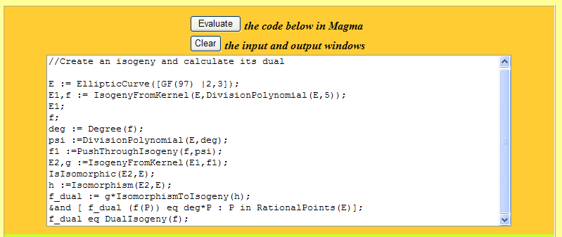
Magma computational Algebra
System

Slide 15
